Slide 1

Welcome to the Riot API Bootcamp!
Know more, win more.

Slide 2








What is the purpose of this course?
Learning to use the Riot API is a bit of a struggle. There's very few resources out there and they're not very structured.
“The Riot API Bootcamp Course is designed to take you from no knowledge up to building your own app.”

Slide 3




Who am i?
Karl, Rocket Scientist & Data Analyst
Past work and collaborations:
Cloud 9
NASA
Wells Fargo
Mozilla
Lockheed Martin
Air Force Research Lab
Siemens, GSK
Experience in everything from AI/ML to jet engine design
“Solve difficult problems with novel methods, by any means necessary”
RebirthNA#2359
@LoL-Genius
417devops@gmail.com

Slide 4
Bootcamp syllabus
Basics (Python, GitHub, Notepad++)
Resources to get started
Setting up an environment
Downloading GitHub repos
JSON explanation & Notepad++ example
Project: read csv file, convert to data frame, create graphs
Riot API introduction
What is an API?
Getting access & Registering your App
What end points are there/what data is available?
Explanation of puuid/account name
Project: make an API call on the website & download the data
Automating API interactions
Introduction to libraries (Cassiopeia, Riot Watcher)
Getting help (documentation, Discord)
Project: automate an API call using a library
Single Endpoint Data
Use case explanation (e.g., in-depth match analysis, leaderboards)
Code example- getting challenger leaderboard
Project: request last 10 games for an account and determine the most common champion(s)
Large Scale Data Collection
Use case explanation (e.g., match history of top 50 players)
Setting up a process pipeline
Comparing 1 file approach vs. functions across files approach
Project: determine number of roles (TOP, MID, etc) on the challenger ladder using the last 5 games
5 Modules covering core topics Project at the end of each

Slide 5
Module 4: Single Endpoint Data
Riot API BOOTCAMP
Slide Deck

Slide 6

Module 4: Small Scale Data
Single Endpoint Data
Use case explanation
Code example- getting challenger leaderboard
Project: request last 25 games for an account and determine the most common champion(s)
Let’s Dive In

Slide 7



Use case explanations
Small-scale data typically means:
1 account
One or two endpoints
Focus is on detailed data
Use case examples:
In-depth match analysis
Leaderboards
Tracking player progression
Checking your profile on a stats website is the most common application of small-scale data (the Riot API gives more than what they show you though!)

Slide 8
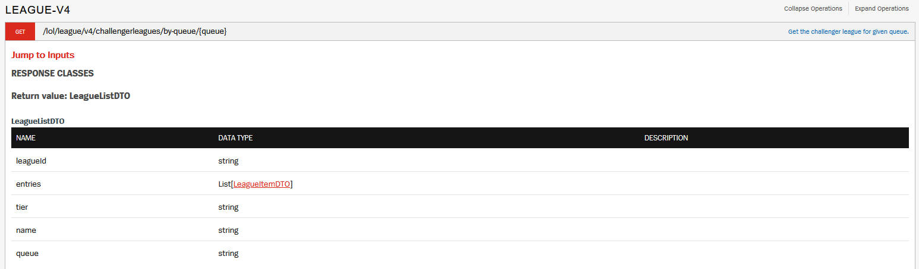
Automating an API request
DEMONSTRATION with
/lol/league/v4/challengerleagues/by-queue/{queue}
Request challenger ladder, look at entries

Slide 9

Project-4 Info
Task List:
Request last 10 games for an account
Determine the most common champion(s)
Let’s Dive In

Slide 10


Questions?
Contact me
It is my hope that this course is easy to understand and follow
Have a question or want additional details? Just reach out!
If you want to know more about my work (LoL Genius) or have questions about something you’re building, LMK!

